Slide 1
2nd Team Project
과목: DSfQM
Professor : 정 욱
C조
BDA 김 채 린
BDA 오 태 훈
BDA 한 상 혁
BDA 차 민 우

Slide 2

Problem 1
(a) Establish appropriate control charts for compressive strength using Table 1. Is the process in statistical control?
(b) After establishing the control charts in part (a), 15 new subgroups were collected and the compressive strengths are shown in Table-Phase II (in second sheet of Strength_Data.xslx). Plot the monitoring statistics against the control limits from part (a) and draw conclusion.

Slide 3
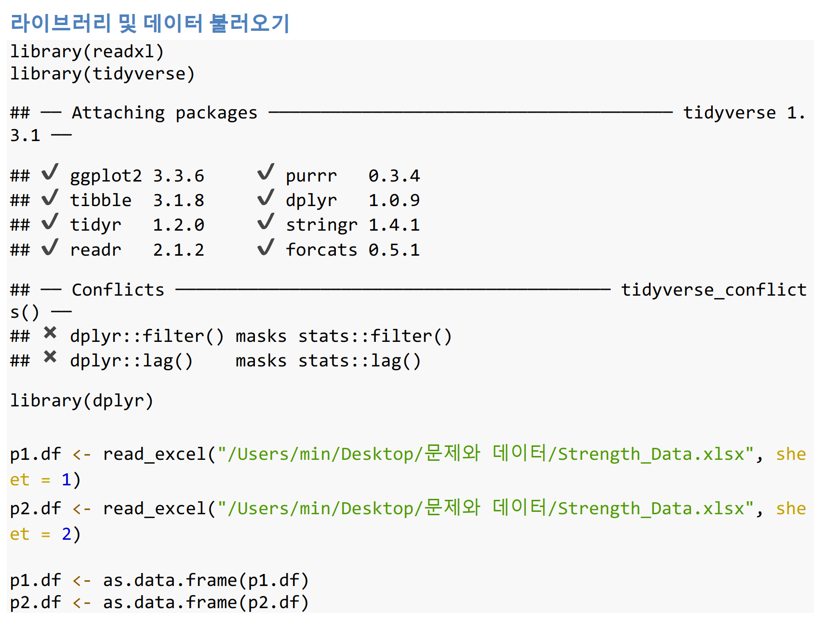
Problem 1 – 데이터 준비

Slide 4
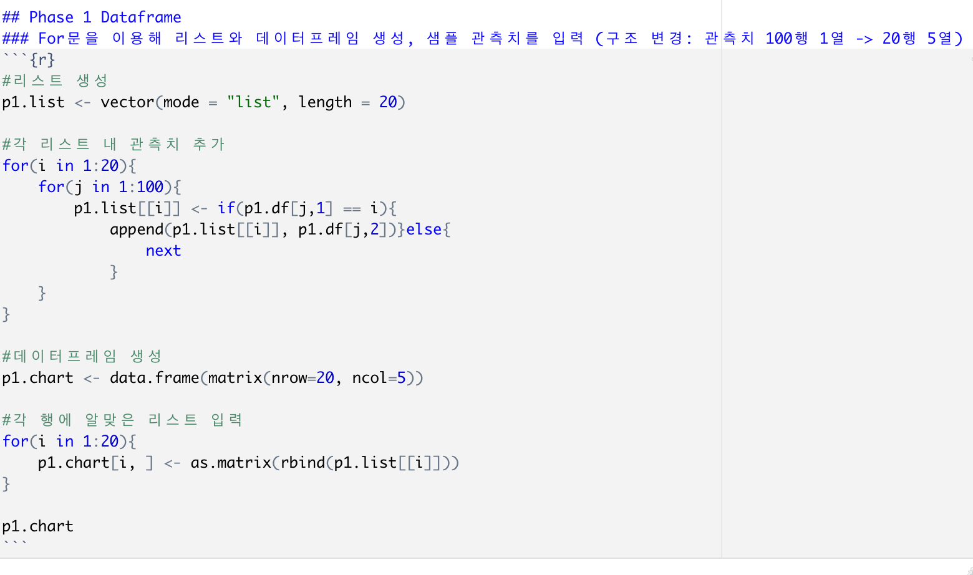
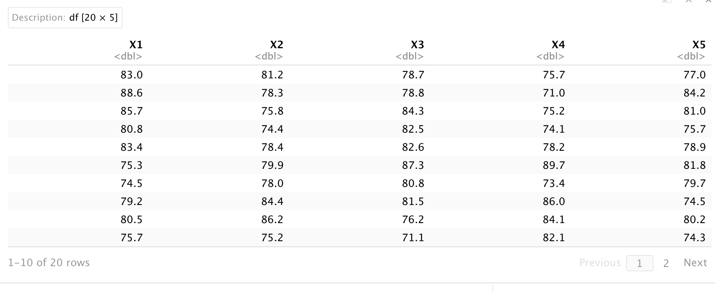
Problem 1 – 데이터 준비

Slide 5
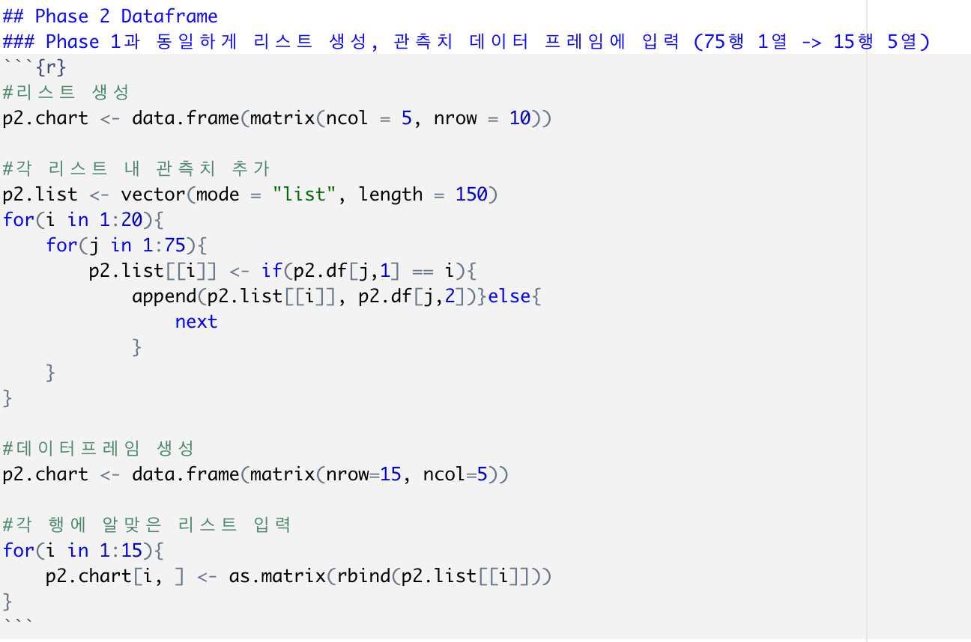
Problem 1 – 데이터 준비

Slide 6
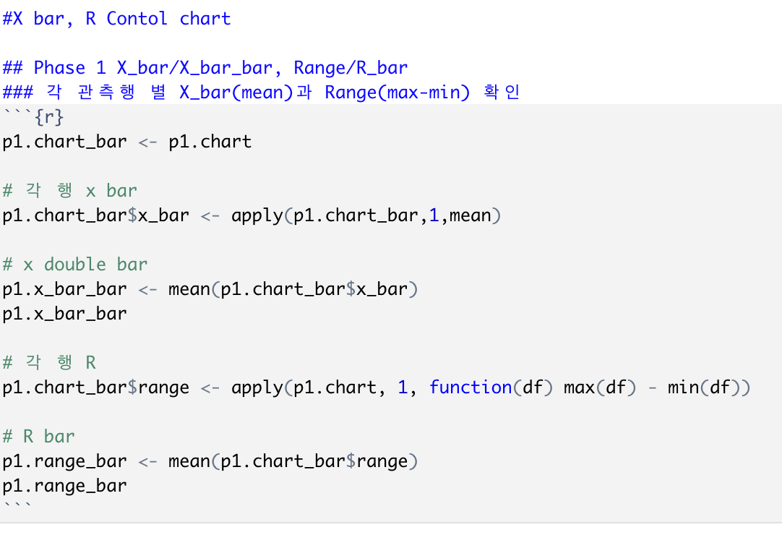
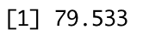
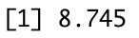
Problem 1 – X bar / R chart

Slide 7
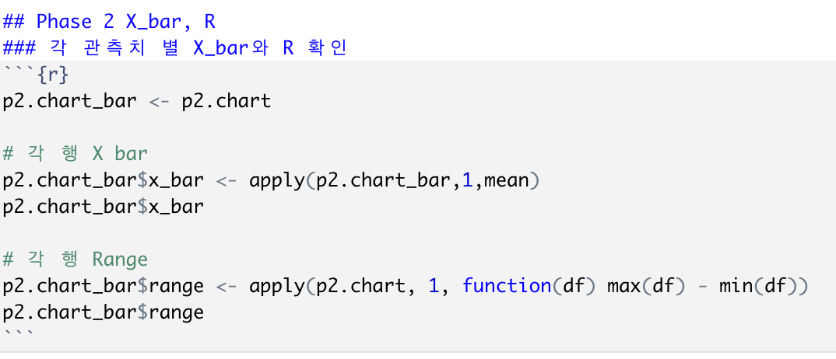
Problem 1 – X bar / R chart

Slide 8
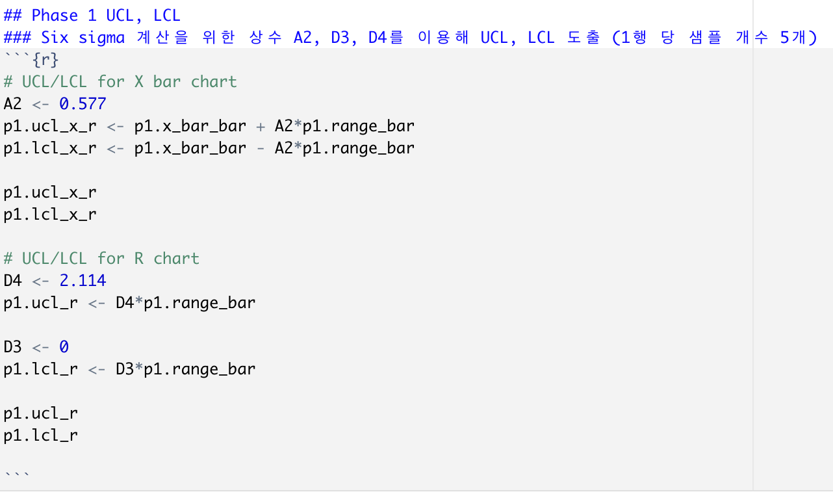
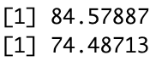
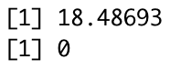
Problem 1 – X bar / R chart

Slide 9
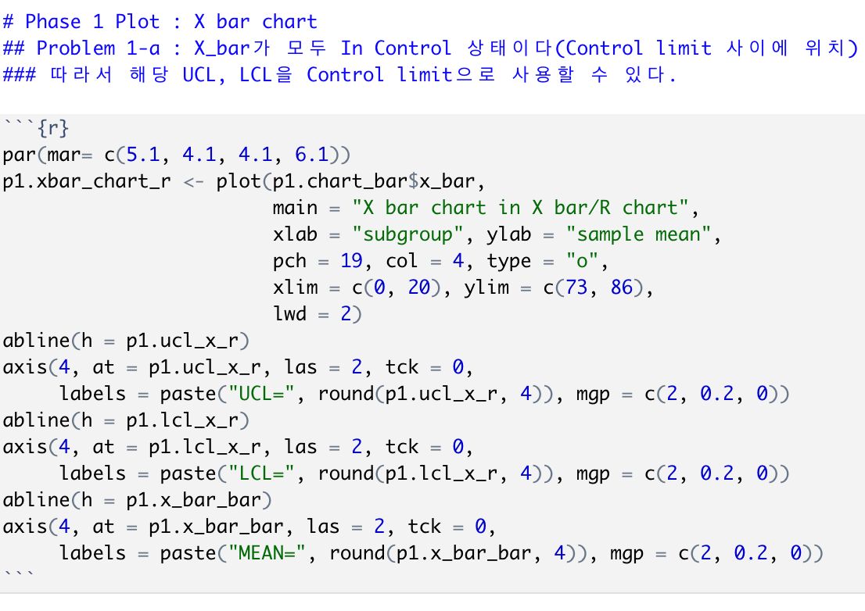
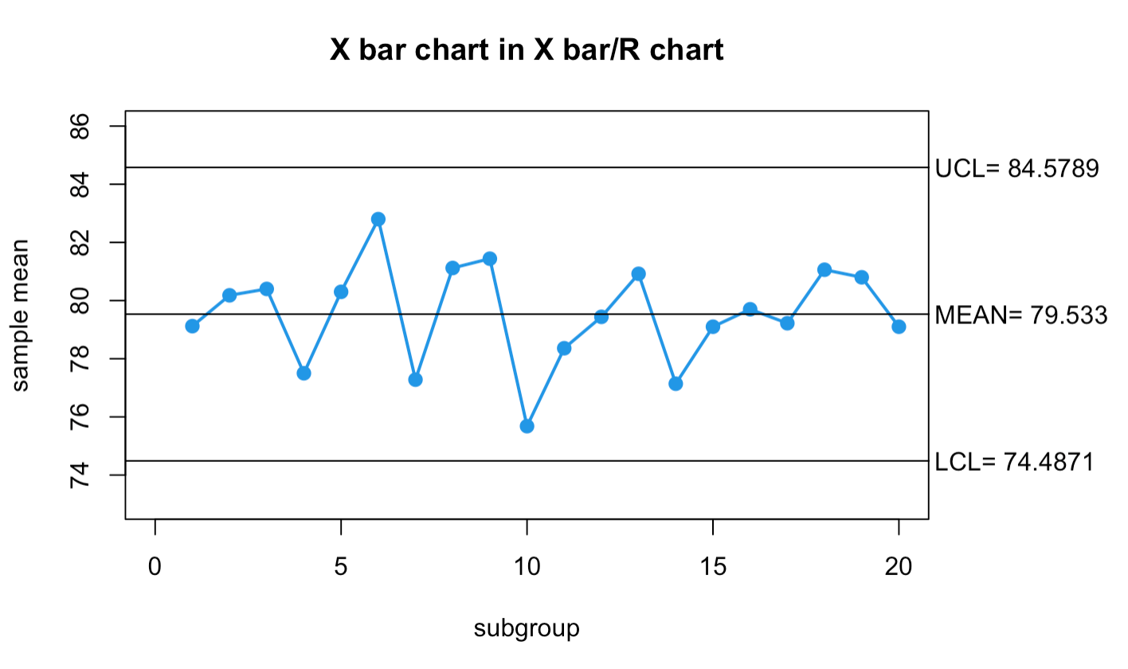
Problem 1 – X bar / R chart

Slide 10
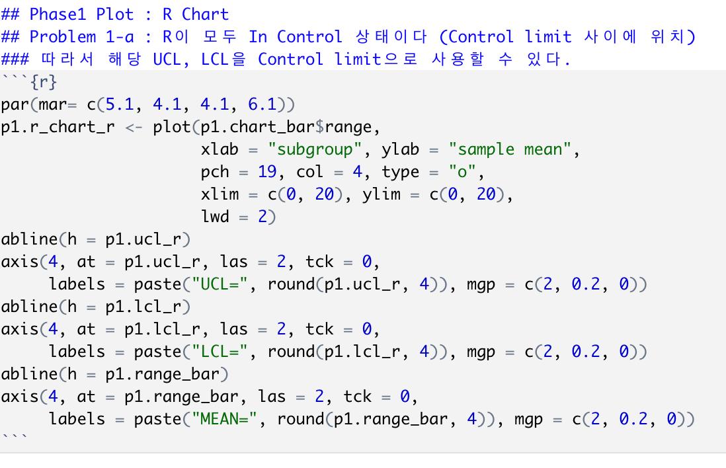
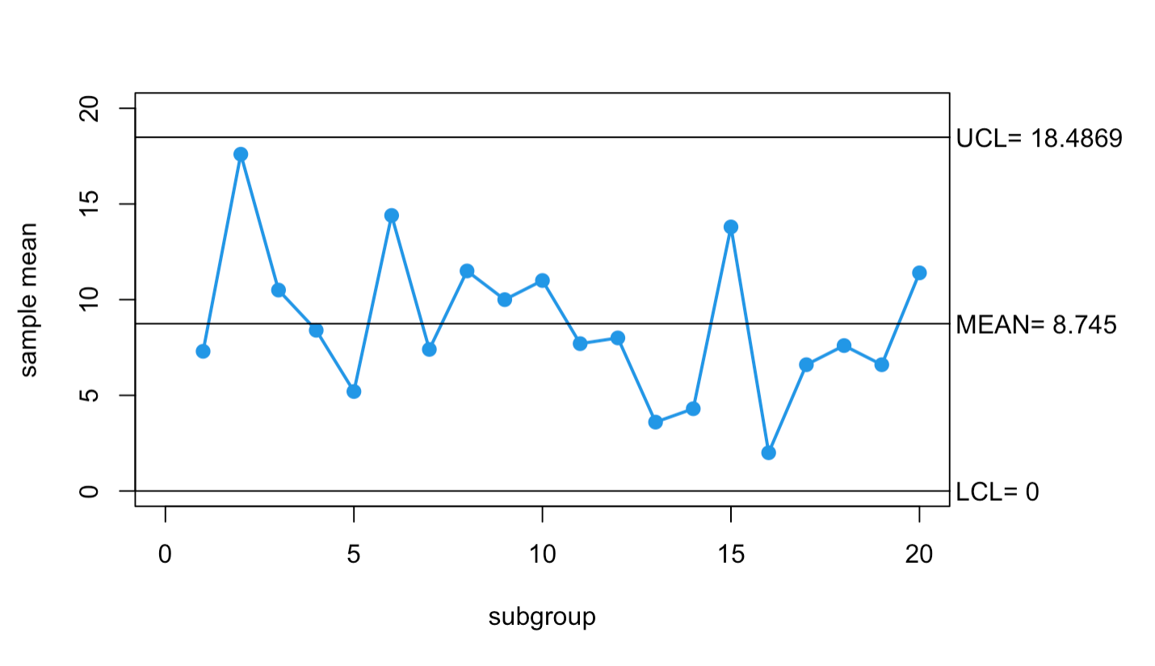
Problem 1 – X bar / R chart

Slide 11
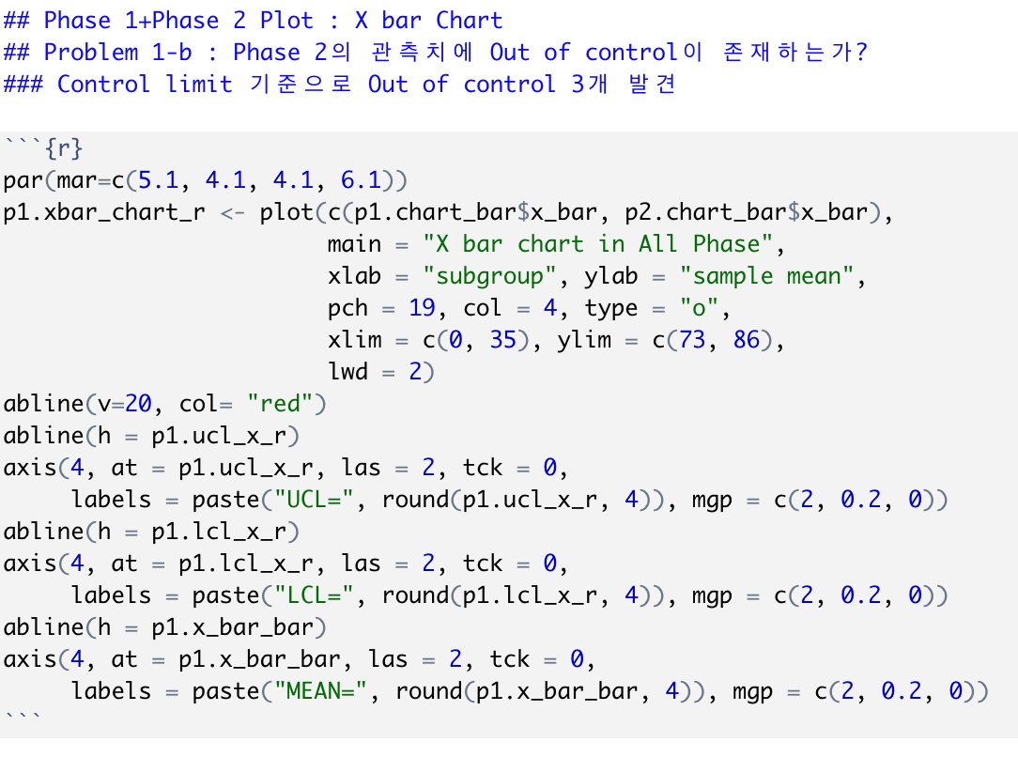
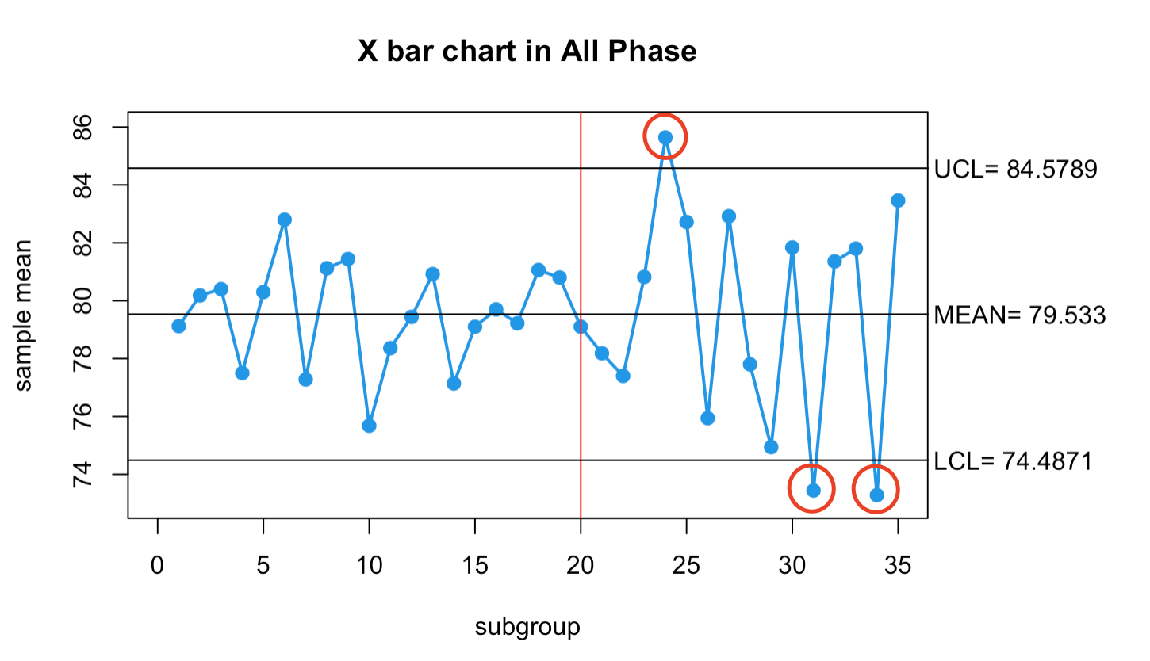
Problem 1 – X bar / R chart

Slide 12
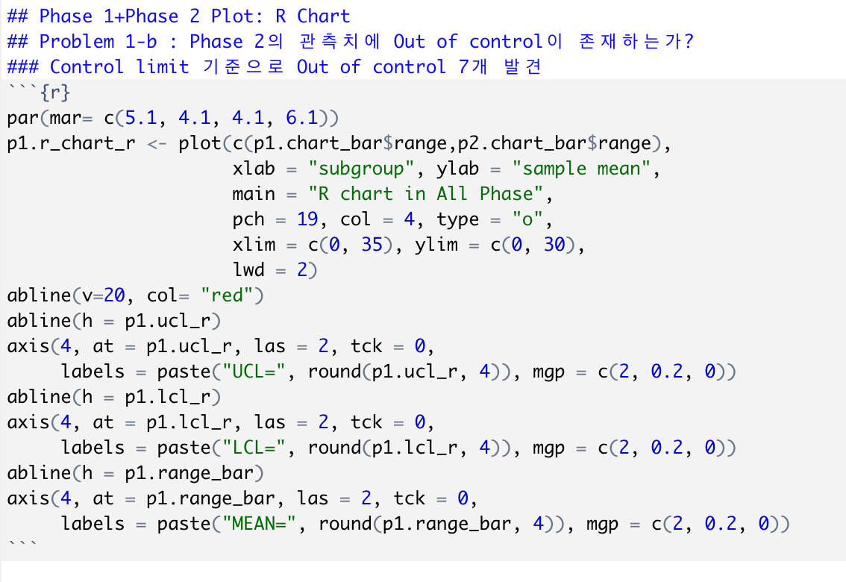
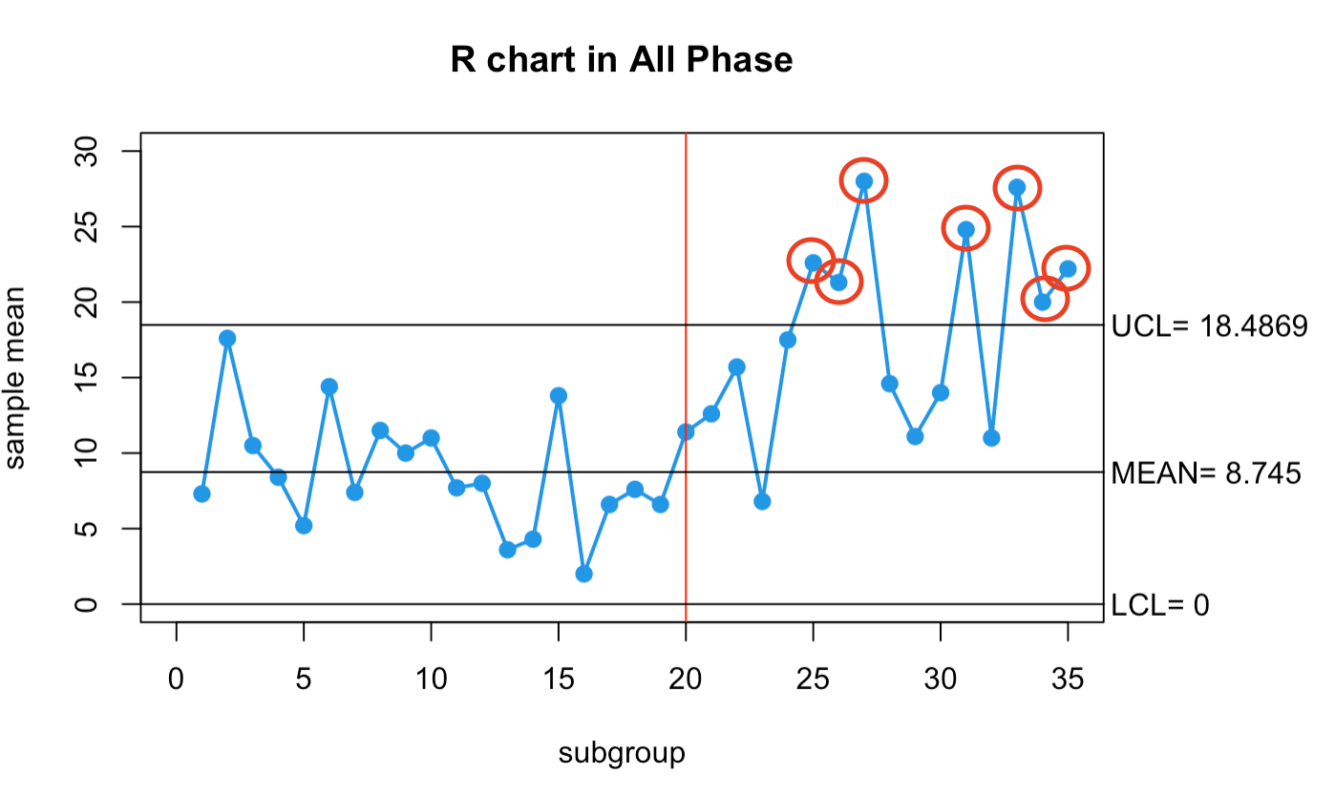
Problem 1 – X bar / R chart

Slide 13

Problem 1
(a) Establish appropriate control charts for compressive strength using Table 1. Is the process in statistical control?
(b) After establishing the control charts in part (a), 15 new subgroups were collected and the compressive strengths are shown in Table-Phase II (in second sheet of Strength_Data.xslx). Plot the monitoring statistics against the control limits from part (a) and draw conclusion.

Slide 14
Problem 1 – X bar / S chart
p1.chart_bar <- p1.chart
# 각 행 x bar
p1.chart_bar$x_bar <- apply(p1.chart_bar,1,mean)
# x double bar
p1.x_bar_bar <- mean(p1.chart_bar$x_bar)
p1.x_bar_bar
## [1] 79.533
# 각 행 SD
p1.chart_bar$sd <- apply(p1.chart, 1, sd)
# S_bar
p1.sd_bar <- mean(p1.chart_bar$sd)
p1.sd_bar
## [1] 3.574917

Slide 15
Problem 1 – X bar / S chart
p2.chart_bar <- p2.chart
# 각 행 X bar
p2.chart_bar$x_bar <- apply(p2.chart_bar,1,mean)
p2.chart_bar$x_bar
## [1] 78.18 77.40 80.82 85.64 82.72 75.94 82.92 77.80 74.94 81.84 73.44 81.
36
## [13] 81.80 73.28 83.46
# 각 행 SD
p2.chart_bar$sd <- apply(p2.chart, 1, sd) # 각 행별 S
p2.chart_bar$sd
## [1] 5.362555 7.649510 2.804817 6.283948 8.551725 8.636434 11.687686
## [8] 6.408198 4.520288 6.012321 10.235868 4.731596 10.333683 7.891578
## [15] 7.895758

Slide 16
Problem 1 – X bar / S chart
# UCL/LCL (X bar chart)
A3 <- 1.427
p1.ucl_x_s <- p1.x_bar_bar + A3*p1.sd_bar
p1.lcl_x_s <- p1.x_bar_bar - A3*p1.sd_bar
p1.ucl_x_s
## [1] 84.63441
p1.lcl_x_s
## [1] 74.43159
# UCL/LCL (S chart)
B4 <- 2.089
p1.ucl_s_s <- B4 * p1.sd_bar
B3 <- 0
p1.lcl_s_s <- B3 * p1.sd_bar
p1.ucl_s_s
## [1] 7.468002
p1.lcl_s_s
## [1] 0

Slide 17
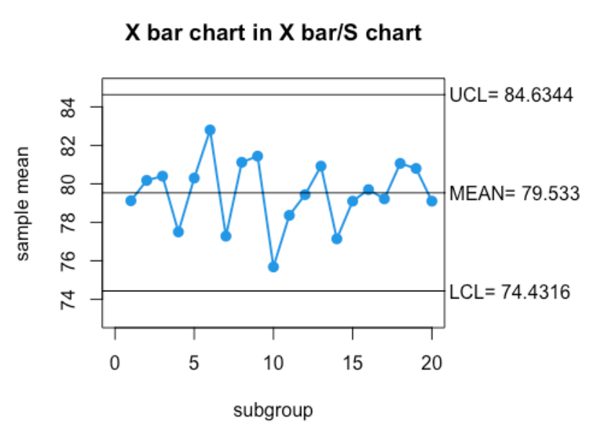
Problem 1 – X bar / S chart
par(mar= c(5.1, 4.1, 4.1, 6.1))
p1.xbar_chart_s <- plot(p1.chart_bar$x_bar,
main = "X bar chart in X bar/S chart",
xlab = "subgroup", ylab = "sample mean",
pch = 19, col = 4, type = "o",
xlim = c(0, 20), ylim = c(73, 85),
lwd = 2)
abline(h = p1.ucl_x_s)
axis(4, at = p1.ucl_x_s, las = 2, tck = 0,
labels = paste("UCL=", round(p1.ucl_x_s, 4)), mgp = c(2, 0.2, 0))
abline(h = p1.lcl_x_s)
axis(4, at = p1.lcl_x_s, las = 2, tck = 0,
labels = paste("LCL=", round(p1.lcl_x_s, 4)), mgp = c(2, 0.2, 0))
abline(h = p1.x_bar_bar)
axis(4, at = p1.x_bar_bar, las = 2, tck = 0,
labels = paste("MEAN=", round(p1.x_bar_bar, 4)), mgp = c(2, 0.2, 0))

Slide 18
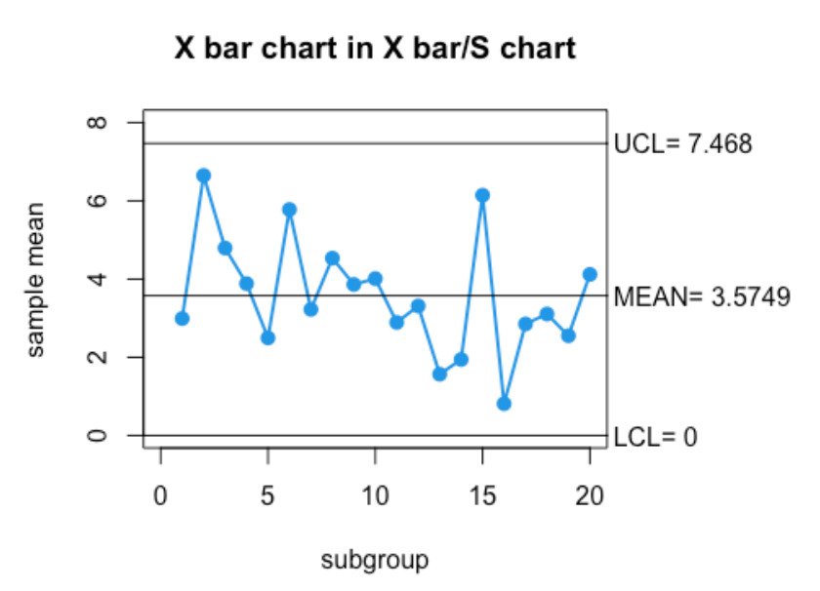
Problem 1 – X bar / S chart
par(mar= c(5.1, 4.1, 4.1, 6.1))
p1.sbar_chart_s <- plot(p1.chart_bar$sd,
main = "X bar chart in X bar/S chart",
xlab = "subgroup", ylab = "sample mean",
pch = 19, col = 4, type = "o",
xlim = c(0, 20), ylim = c(0,8),
lwd = 2)
abline(h = p1.ucl_s_s)
axis(4, at = p1.ucl_s_s, las = 2, tck = 0,
labels = paste("UCL=", round(p1.ucl_s_s, 4)), mgp = c(2, 0.2, 0))
abline(h = p1.lcl_s_s)
axis(4, at = p1.lcl_s_s, las = 2, tck = 0,
labels = paste("LCL=", round(p1.lcl_s_s, 4)), mgp = c(2, 0.2, 0))
abline(h = p1.sd_bar)
axis(4, at = p1.sd_bar, las = 2, tck = 0,
labels = paste("MEAN=", round(p1.sd_bar, 4)), mgp = c(2, 0.2, 0))

Slide 19
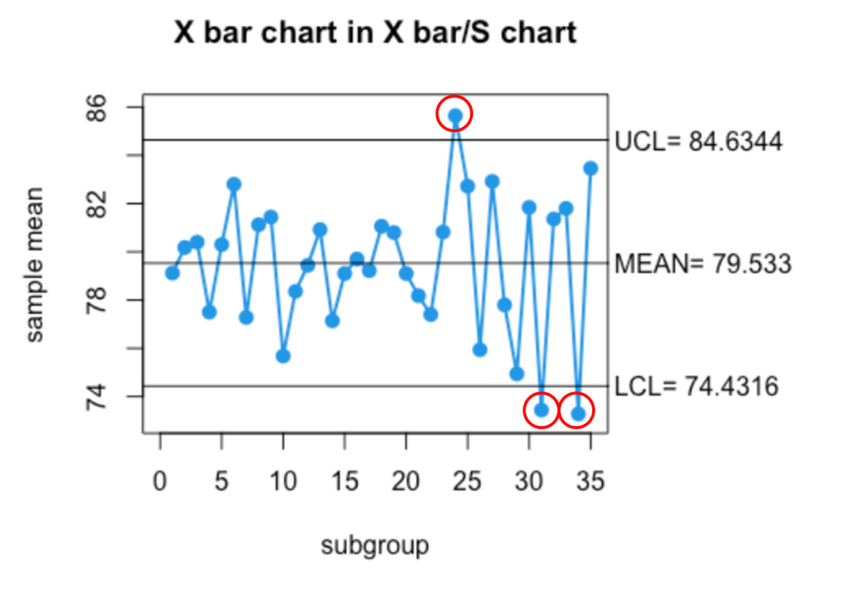
Problem 1 – X bar / S chart
par(mar= c(5.1, 4.1, 4.1, 6.1))
p2.xbar_chart_s <- plot(c(p1.chart_bar$x_bar, p2.chart_bar$x_bar),
main = "X bar chart in X bar/S chart",
xlab = "subgroup", ylab = "sample mean",
pch = 19, col = 4, type = "o",
xlim = c(0, 35), ylim = c(73, 86),
lwd = 2)
abline(h = p1.ucl_x_s)
axis(4, at = p1.ucl_x_s,
las = 2, tck = 0,
labels = paste("UCL=",round(p1.ucl_x_s, 4)),
mgp = c(2, 0.2, 0))
abline(h = p1.lcl_x_s)
axis(4, at = p1.lcl_x_s,
las = 2, tck = 0,
labels = paste("LCL=", round(p1.lcl_x_s, 4)),
mgp = c(2, 0.2, 0))
abline(h = p1.x_bar_bar)
axis(4, at = p1.x_bar_bar,
las = 2, tck = 0,
labels = paste("MEAN=", round(p1.x_bar_bar, 4)),
mgp = c(2, 0.2, 0))

Slide 20
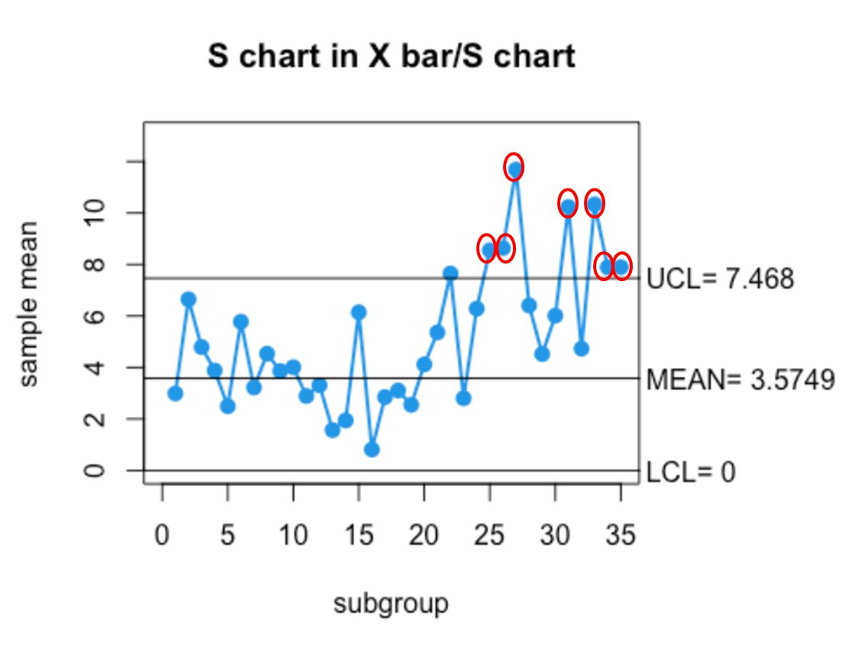
Problem 1 – X bar / S chart
par(mar= c(5.1, 4.1, 4.1, 6.1))
p2.sbar_chart_s <- plot(c(p1.chart_bar$sd, p2.chart_bar$sd),
main = "S chart in X bar/S chart",
xlab = "subgroup", ylab = "sample mean",
pch = 19, col = 4, type = "o",
xlim = c(0, 35), ylim = c(0,13),
lwd = 2)
abline(h = p1.ucl_s_s)
axis(4, at = p1.ucl_s_s,
las = 2, tck = 0,
labels = paste("UCL=", round(p1.ucl_s_s, 4)),
mgp = c(2, 0.2, 0))
abline(h = p1.lcl_s_s)
axis(4, at = p1.lcl_s_s,
las = 2, tck = 0,
labels = paste("LCL=", round(p1.lcl_s_s, 4)),
mgp = c(2, 0.2, 0))
abline(h = p1.sd_bar)
axis(4, at = p1.sd_bar,
las = 2, tck = 0,
labels = paste("MEAN=", round(p1.sd_bar, 4)),
mgp = c(2, 0.2, 0))

Slide 21
Problem 2
(a) Is there evidence that uniformity is normally distributed? If not, find a suitable transformation for the data.
(b) Construct a control chart for individuals and a moving range control chart for uniformity for the etching process. Is the process in statistical control?

Slide 22
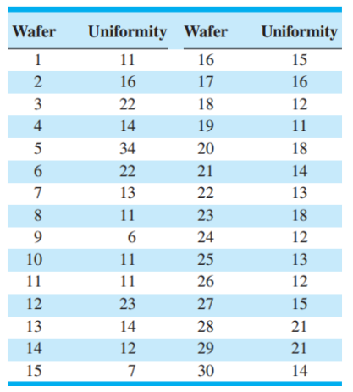
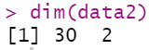
2-(a)

Slide 23
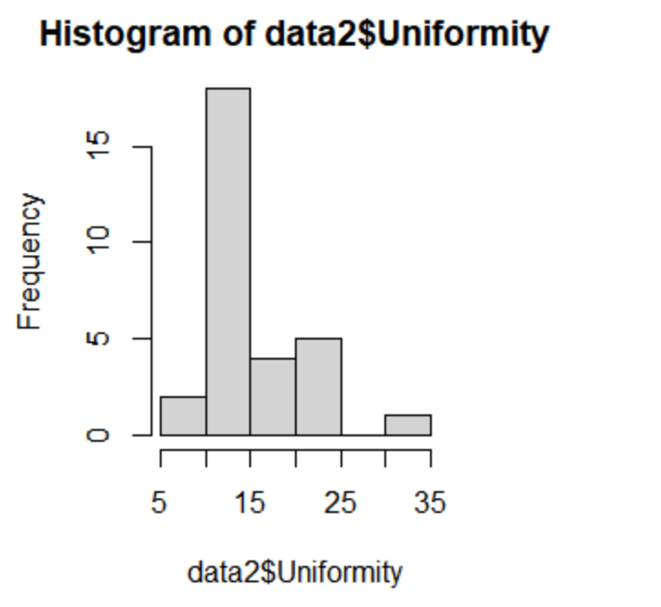
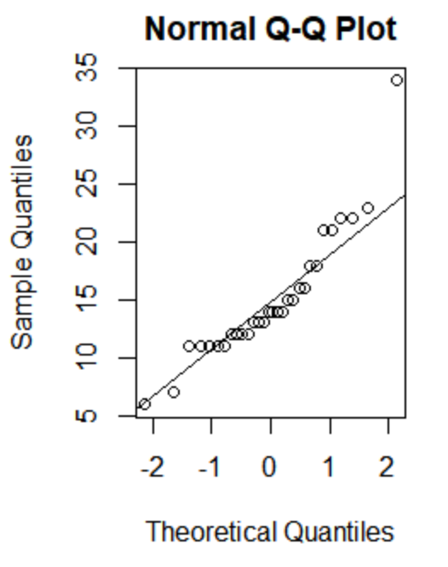
2-(a)

Slide 24
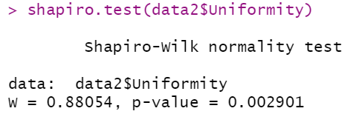
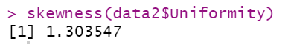
2-(a)
h0 : 정규분포 따른다.
h1 : 정규분포를 따르지 않는다.
P-value가 0.05보다 작으므로 귀무가설 h0를 기각한다.
따라서 Uniformity는 정규분포를 따른다고 볼 수 없다.

Slide 25
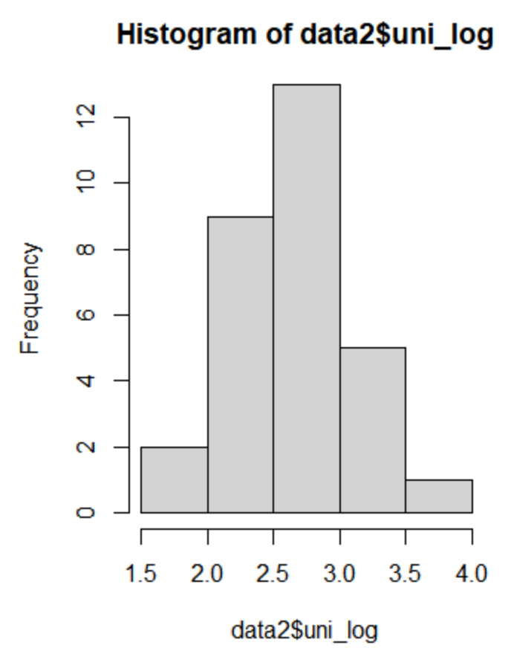
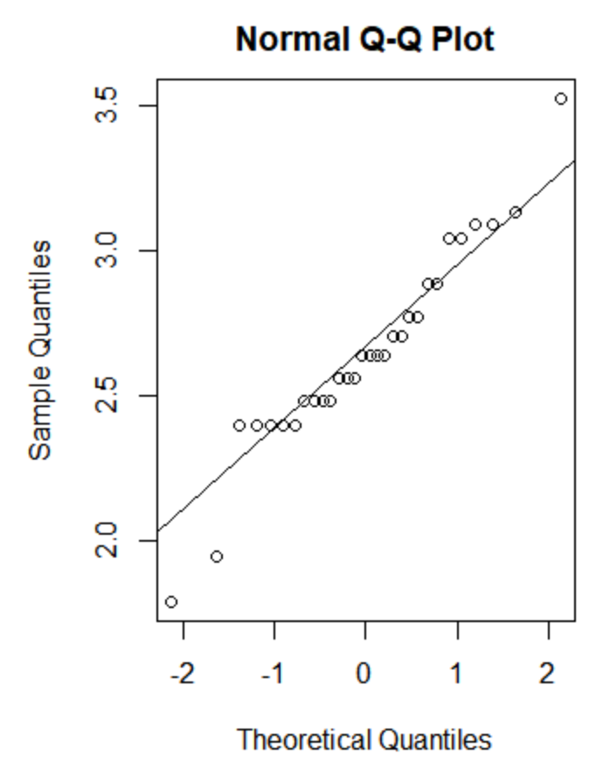
2-(a)
1) 로그변환

Slide 26
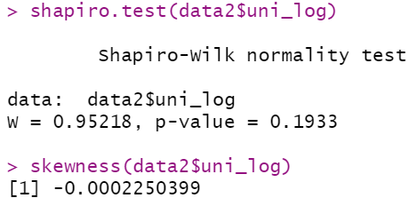
2-(a)
1) 로그변환

Slide 27
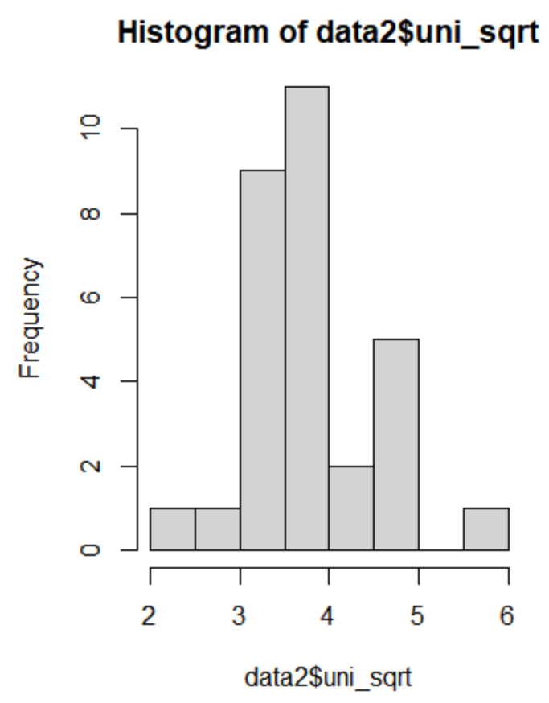
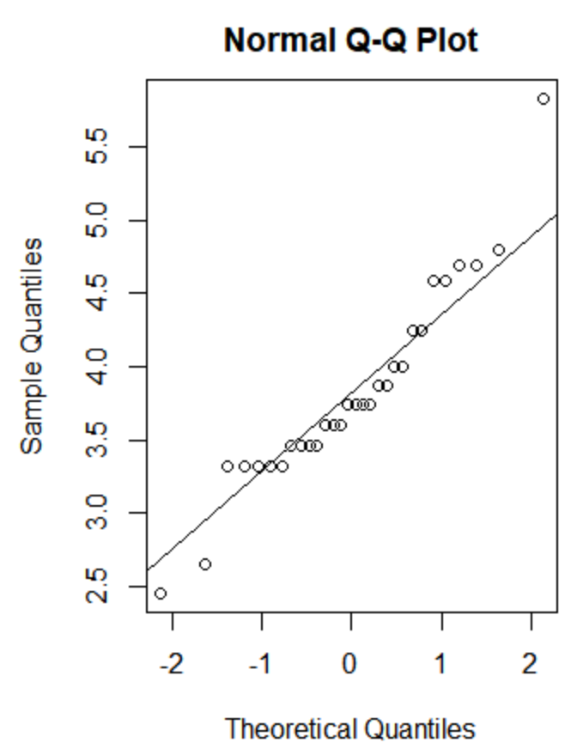
2-(a)
2) 제곱근 변환

Slide 28
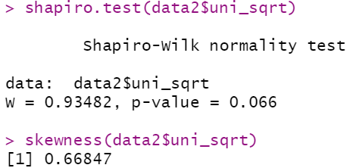
2-(a)
2) 제곱근 변환

Slide 29
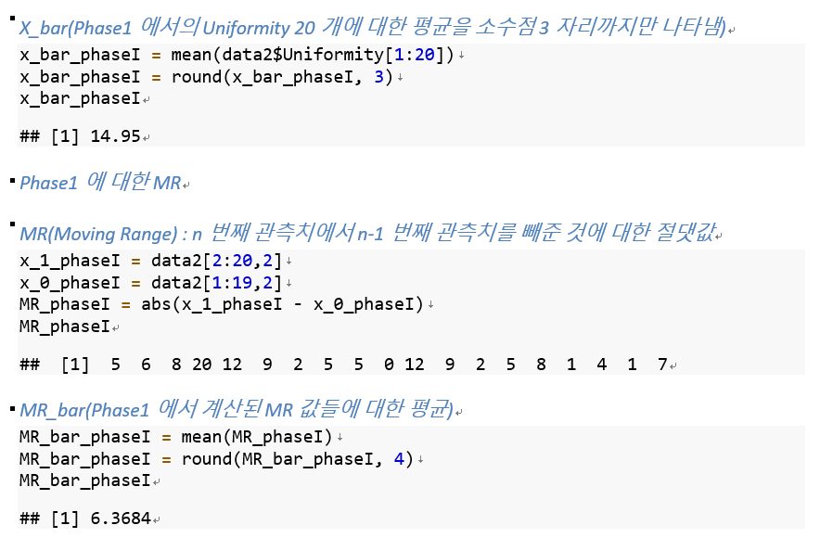

2-(b)
1) I-Chart

Slide 30
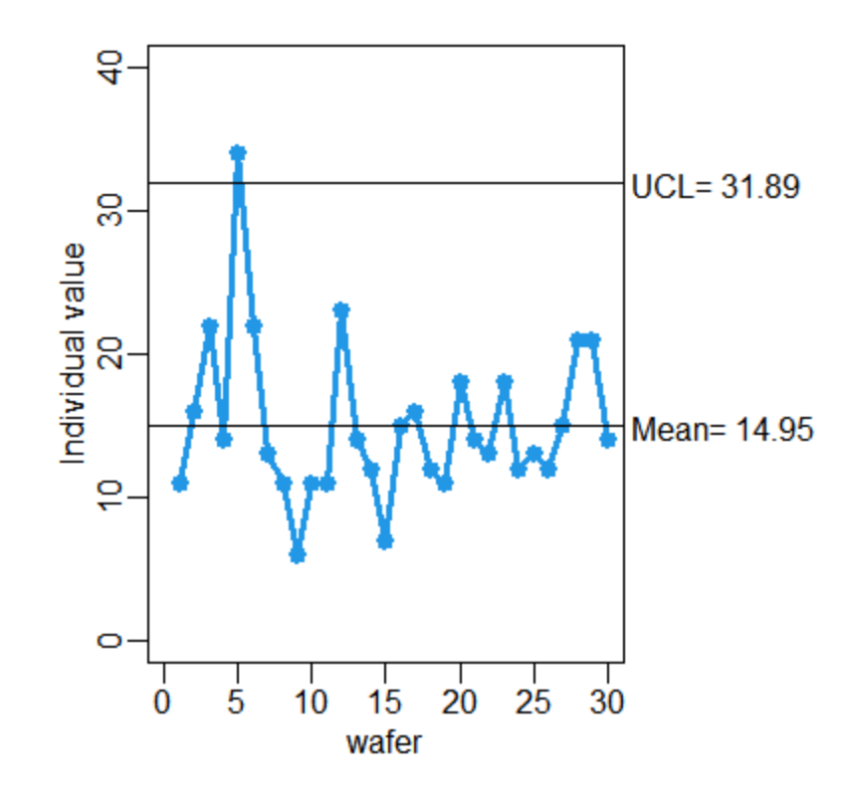
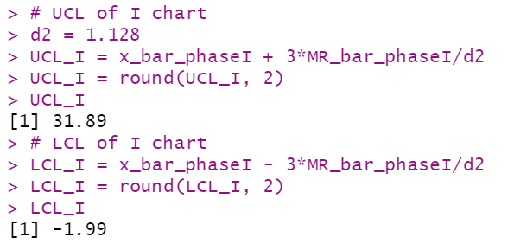
2-(b)
1) I-Chart

Slide 31
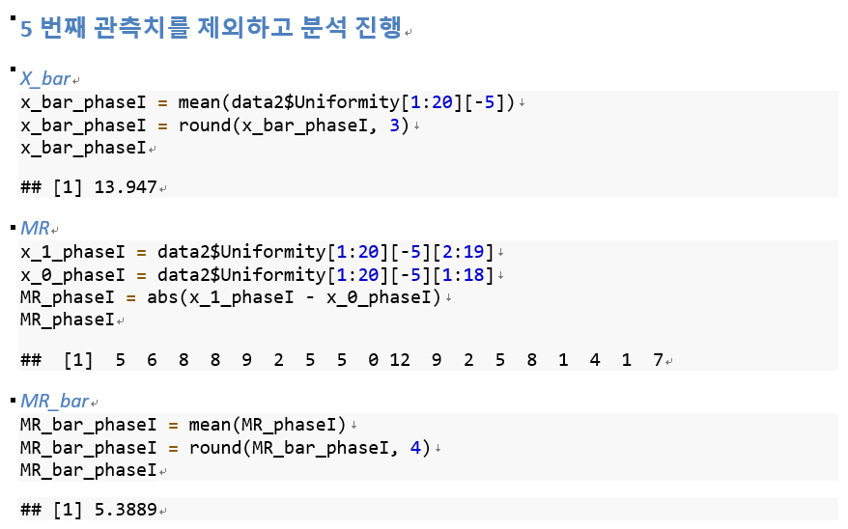
2-(b)
1) I-Chart

Slide 32
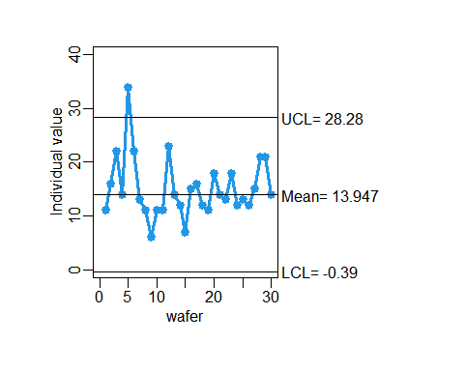
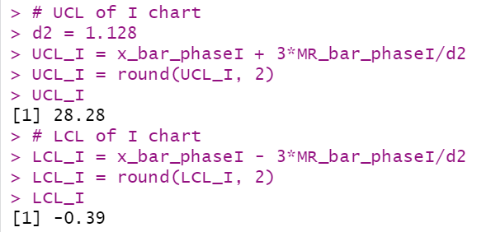
2-(b)
1) I-Chart
Notes:
Phase1에서 5번째 관측치를 제외하고 계산한 UCL은 28.28, LCL은 -0.39이고 평균은 13.947입니다. 이 값을 토대로 모든 관측치들에 대한 I-CHART를 만들었는데 5번째 관측치를 제외하고 모든 관측치들이 UCL과 LCL을 벗어나지 않고 control limit 안에 잘 위치하고 있습니다. 따라서 이번에 생성된 i-chart 상에서는 모든 관측치들이 in-control 상태에 있다고 볼 수 있겠습니다.

Slide 33
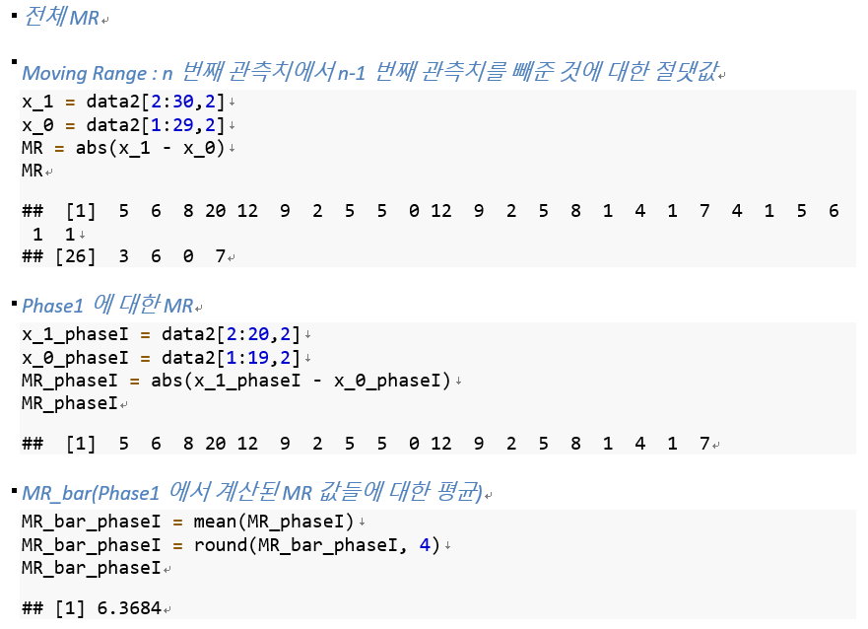
2-(b)
2) MR-Chart

Slide 34
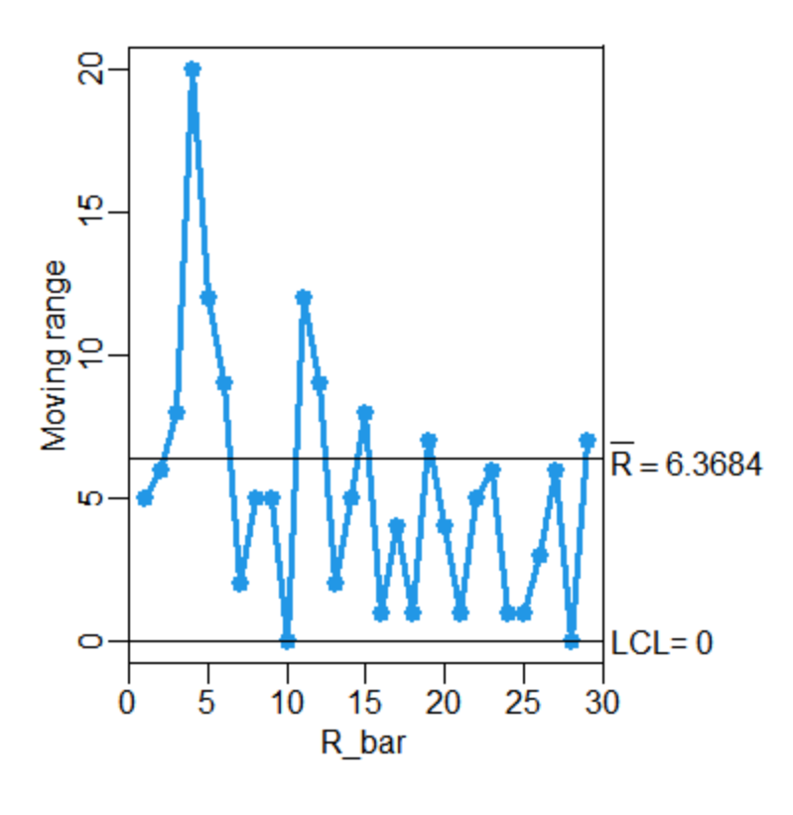
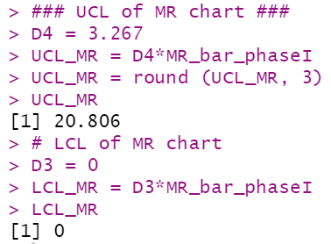
2-(b)
2) MR-Chart

Slide 35
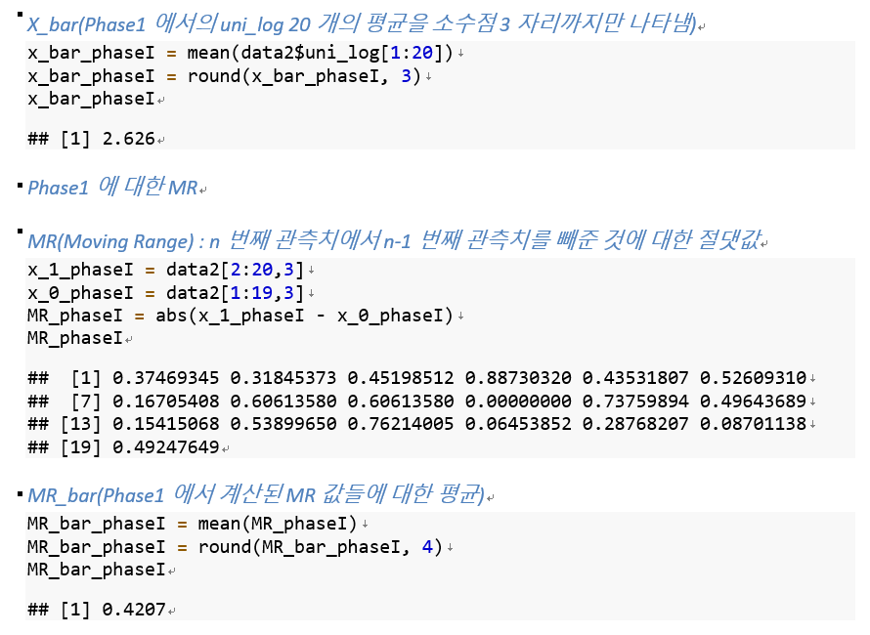
2-(b)
3) uni-log에 대한 I-Chart

Slide 36
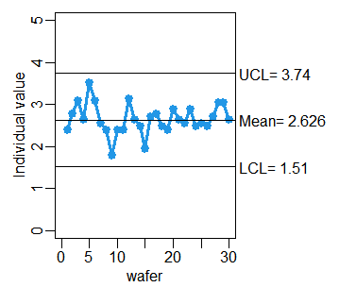
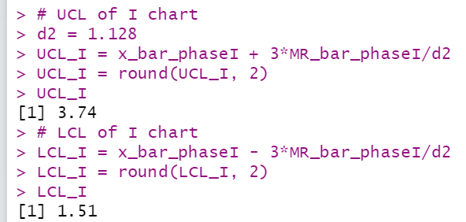
2-(b)
3) uni-log에 대한 I-Chart

Slide 37
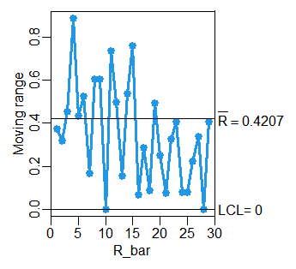
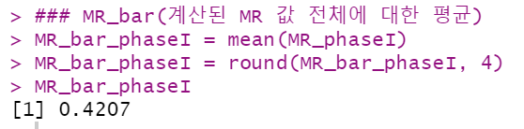
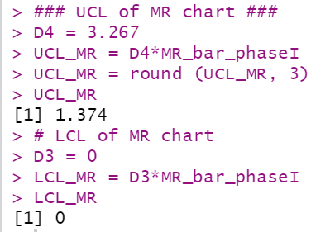
2-(b)
4) uni-log에 대한 MR-Chart

Slide 38
감사합니다

